Slide 1
NYC EMS Incident Response Time
Syeda Nahar
Healthfirst Date Analytics Academy Capstone Project

Slide 2
NYC Open Data: EMS Incident Dispatch Data
Data Generated by the EMS Computer Aided Dispatch System.
Contains 29.6M Rows (Incident Reports Generated from 2005 to March 2026) and 31 Columns.
For my research, I will only focus on data from 2024 (~1.5M Records).
Notes:
Dataset: Each row is an incident with a unique ID number (the primary key). Only working with 2024 data to make the task for manageable.

Slide 3
Does EMS response times vary significantly by Borough?
Pandas & NumPy
Data Cleaning
Missing Data Check
Descriptive Statistics
Matplotlib:
Visual Analysis
SciPy & Statsmodel
Regression Analysis
Research Question
Methodology
Notes:
The purpose of my research is to analyze NYC EMS response time and if it varies by borough depending on the severity of the incident, and time or day of the week.

Slide 4
Data Cleaning/Transformation
Convert
Timestamp fields from strings to datetime objects.
Response time from seconds to minutes.
Severity code from text to numeric values.
Extract hour, month, weekday, and weekend from incident_datetime.
Remove missing values from the borough field.

Slide 5
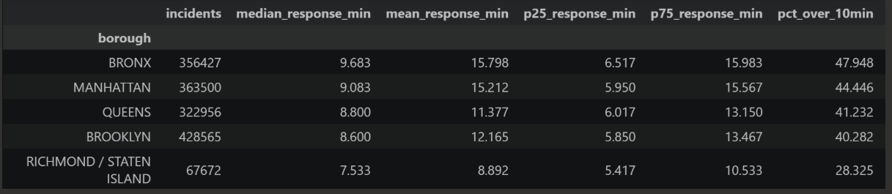
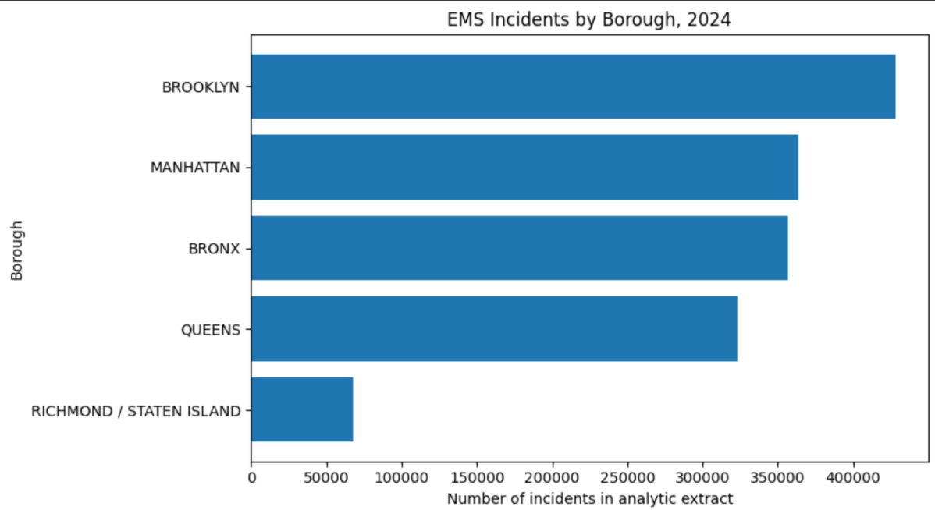
Descriptive Analysis: Response Time by Borough
The table above shows number of incidents and response time distribution by borough. Brooklyn has the highest number of incidents while Staten Island has the lowest.
Notes:
EMS response-time data are right-skewed. In every borough, the mean response time is higher than the median. This means most responses occur within a moderate range, but some very long response times pull the average upward.

Slide 6
Data Visualization

Slide 7
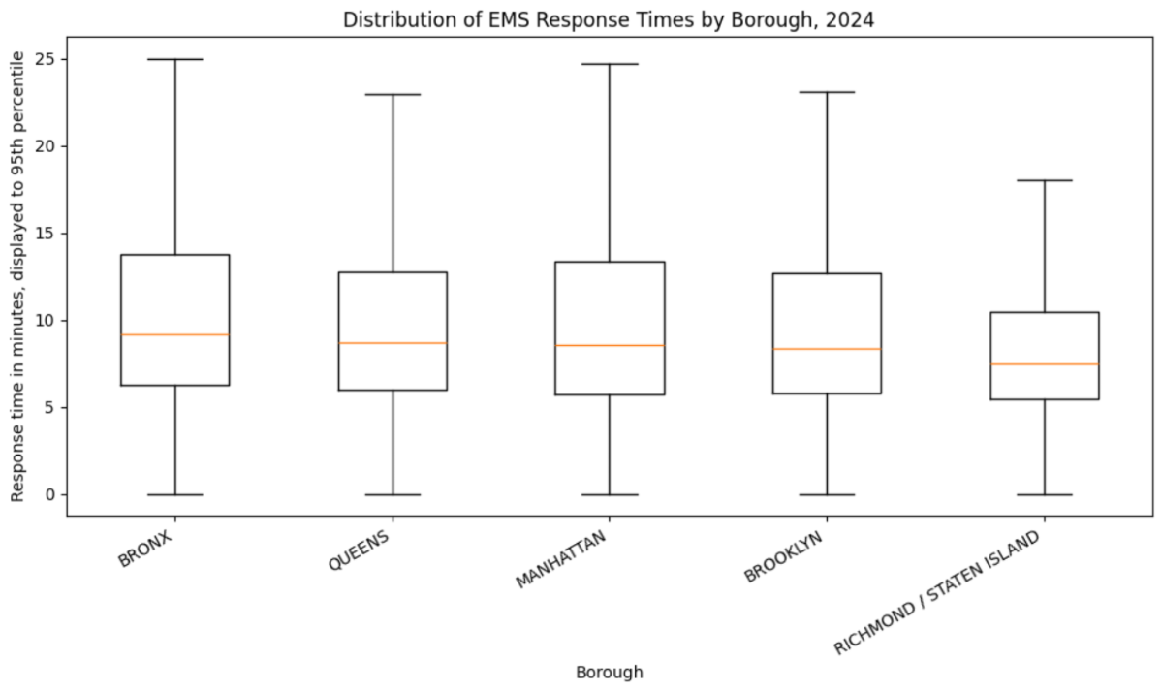
Notes:
Borough differences are not caused only by outliers. The median lines and middle ranges differ across boroughs, meaning the typical response-time experience is different depending on borough.

Slide 8
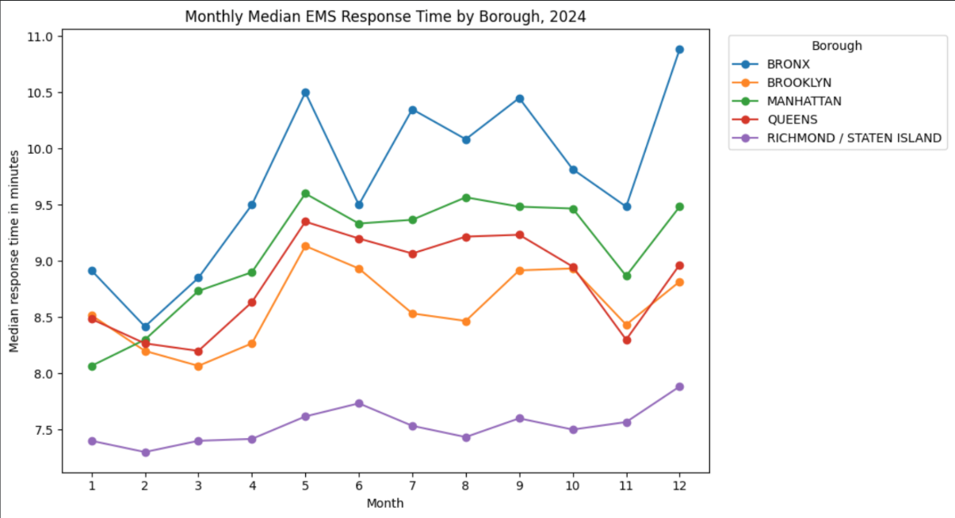
Notes:
Seasonal patterns are visible. Median response times tend to rise in several boroughs during late spring, summer, early fall, and December. The Bronx especially shows noticeable increases in May, July, September, and December.

Slide 9
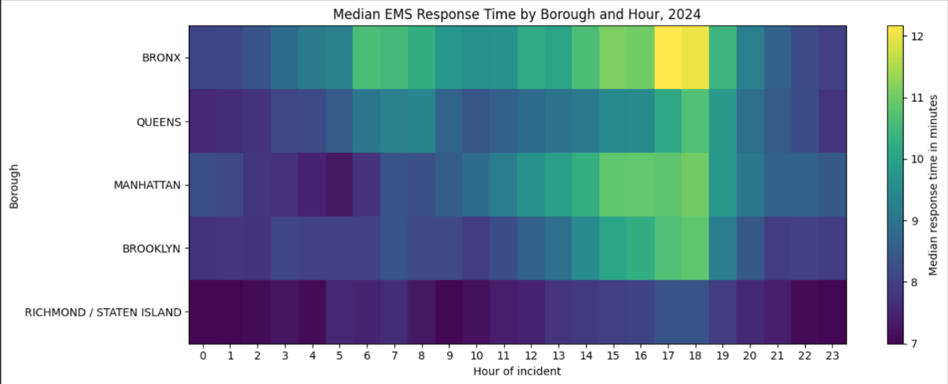
Median EMS Response Time by Borough and Hour
Notes:
Time of day matters. The heatmap shows that response times are generally lower overnight and higher during the afternoon and early evening.
The worst time window appears to be around 3 PM to 6 PM. Several boroughs show darker/lighter heatmap values during this period, especially the Bronx, suggesting higher median response times during peak daytime or evening demand.

Slide 10
Regression Analysis
Probability of response time being over 10mins (statistically significant with an overall with a p-value of 0.000) :
Using Brooklyn as the reference borough and holding incident severity, shift, weekday, month, and held status constant, EMS incidents in Queens (7.8%) and the Bronx (6.8%) has a significantly higher odds of exceeding a 10-minute response threshold than incidents in Brooklyn. Manhattan and Staten Island had significantly lower adjusted odds of delay.
Using Friday as a reference day, though all the other days have a lower odd of delays, Saturday (12.4%) and Sunday (15.2%) have lowest odds of delayed response than Friday.

Slide 11
Conclusion
EMS response times does vary by borough. The Bronx has the longest median response time at 9.68 minutes, followed by Manhattan at 9.08 minutes. Staten Island has the shortest median response time at 7.53 minutes. Brooklyn has the highest incident volume, but not the worst response times.
Staten Island consistently performs better than the other boroughs. It has the lowest median response time, lowest average response time, lowest percentage over 10 minutes, and lowest held percentage. Only about 28% of Staten Island incidents exceeded 10 minutes, compared with nearly 48% in the Bronx.
The Bronx shows the greatest response-time burden. It has the highest median response time, highest mean response time, and highest percentage of calls over 10 minutes. Nearly 48% of Bronx EMS incidents exceeded 10 minutes. In the monthly trend chart, the Bronx line is usually above the other boroughs, suggesting that its longer response times are persistent rather than an outlier.
Notes:
EMS response delays are unevenly distributed across New York City. The Bronx experiences the greatest response-time burden, with the highest median response time, and highest percentage of incidents over 10 minutes. Staten Island consistently has the shortest response times and lowest delay rates. Overall, the evidence suggests that EMS response delay is influenced by geography, temporal demand patterns, and operational constraints such as held incidents.

Slide 12
Thank You!
Questions?

